Slide 1
Module 3
A. Data Path and Control

Slide 2
Content
DATA PATH AND CONTROL
REGISTERS
BASIC COMPUTER INSTRUCTIONS
COMMON BUS SYSTEM
MEMORY

Slide 3
Central Processing Unit (CPU)
Arithmetic / Logic Unit
Performs calculations and decisions
Coordinates processing steps
Control Unit
Small, fast storage areas for instructions and data
Registers
Figure 2 Central processing unit

Slide 4
Data Path and Control
The CPU can be divided into a data section and a control section. The data section is also called as the datapath.
Datapath: Components of the processor that perform arithmetic operations and holds data. The registers, the ALU, and the interconnecting bus are collectively referred to as the datapath. The datapath is capable of performing certain operations on data items.
Control section :Component of the processor which is basically the control unit, that issues control signals to the datapath. It commands the datapath, memory, I/O devices according to the instructions of the memory.

Slide 5
Data Path and Control
Datapath: Elements that process data and addresses in the CPU
Memories, registers, ALUs, Buses…
Register
File
ALU
Control Unit

Slide 6
Registers
Registers are very fast computer memory which are used to execute programs and operations efficiently [1]. There are several different classes of CPU:
Accumulator: This is the most frequently used register used to store data taken from memory.
Memory Address Registers (MAR): It holds the address of the location to be accessed from memory. MAR and MDR (Memory Data Register) together facilitate the communication of the CPU and the main memory.
Memory Data Registers (MDR): It contains data to be written into or to be read out from the addressed location.
General Purpose Registers: (GPRs): These are numbered as R₀, R₁, R₂….R_{n}, and used to store temporary data during any ongoing operation. Its content can be accessed by assembly programming.
Instruction Register (IR): It is the register which holds the instruction which is currently been executed.

Slide 7
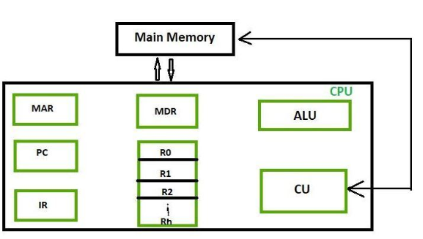
Registers
Program Counter (PC): is used to keep the track of execution of the program. It contains the memory address of the next instruction to be fetched. PC points to the address of the next instruction to be fetched from the main memory when the previous instruction has been successfully completed.
Figure 3 processor registers

Slide 8

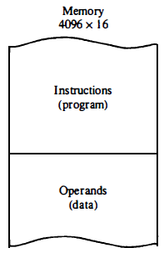


A General-Purpose Computer
An instruction is a group of bits that instruct the computer to perform a specific operation.
It is usually divided into parts.
Instructions are stored in one section of memory and data in another.
The memory has 4096 words
4096 = 2¹², so it takes 12 bits to specify an address to select a word in memory
Each word is 16 bits long
Figure 1 General purpose computer [1]
In a 16-bit memory word, 4 bits are available for the operation code to specify one out of 16 possible operations, and rest 12 bits to specify address of an operand.
Computers that have a single-processor register called accumulator and label it AC.
The operation is performed with the memory operand and the content of AC.

Slide 9
Processor Registers in General-Purpose Computer
A processor has many registers to hold instructions, addresses, data, etc
The processor has a register, the Program Counter (PC) that holds the memory address of the next instruction to get
Since the memory in the Basic Computer only has 4096 locations, the PC only needs 12 bits
In a direct or indirect addressing, the processor needs to keep track of what locations in memory it is addressing: The Address Register (AR) is used for this
The AR is a 12 bit register in the Basic Computer
When an operand is found, using either direct or indirect addressing, it is placed in the Data Register (DR). The processor then uses this value as data for its operation
The Basic Computer has a single general purpose register – the Accumulator (AC)

Slide 10
PROCESSOR REGISTERS
The significance of a general purpose register is that it can be referred to in instructions
e.g. load AC with the contents of a specific memory location; store the contents of AC into a specified memory location
Often a processor will need a scratch register to store intermediate results or other temporary data; Here, it is known as the Temporary Register (TR)
The Basic Computer uses a very simple model of input/output (I/O) operations
Input devices are considered to send 8 bits of character data to the processor
The processor can send 8 bits of character data to output devices
The Input Register (INPR) holds an 8 bit character gotten from an input device
The Output Register (OUTR) holds an 8 bit character to be send to an output device

Slide 11
BASIC COMPUTER REGISTERS
Registers in the Basic Computer
11
0
PC
Memory
11
0
4096 x 16
AR
15
0
IR
CPU
15
0
15
0
TR
DR
7
0
7
0
15
0
OUTR
INPR
AC
List of BC Registers
DR 16 Data Register Holds memory operand
AR 12 Address Register Holds address for memory
AC 16 Accumulator Processor register
IR 16 Instruction Register Holds instruction code
PC 12 Program Counter Holds address of instruction
TR 16 Temporary Register Holds temporary data
INPR 8 Input Register Holds input character
OUTR 8 Output Register Holds output character
Figure 4 Basic computer registers [1]

Slide 12
GENERAL REGISTER ORGANIZATION
Clock
Input
R1
R2
R3
R4
R5
R6
R7
Load
(7 lines)
{
MUX
MUX
}
SELB
SELA
3 x 8
A bus
B bus
decoder
SELD
ALU
OPR
Output
Figure 5. General Register Organization [1]

Slide 13
INSTRUCTIONS
Program
A sequence of (machine) instructions
(Machine) Instruction
A group of bits that tell the computer to perform a specific operation (a sequence of micro-operation)
The instructions of a program, along with any needed data are stored in memory
The CPU reads the next instruction from memory
It is then placed in an Instruction Register (IR)
Control circuitry in control unit then translates the instruction into the sequence of microoperations necessary to implement it
Instruction Fetch
Instruction Decode

Slide 14
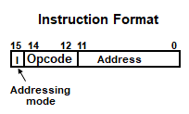
INSTRUCTION FORMAT
A computer instruction is often divided into two parts
An opcode (Operation Code) that specifies the operation for that instruction
An address that specifies the registers and/or locations in memory to use for that operation
In the Basic Computer, since the memory contains 4096 (= 2¹²) words, we needs 12 bit to specify which memory address this instruction will use
The most significant bit, i.e., bit #15 of the instruction specifies the addressing mode (0: direct addressing, 1: indirect addressing)
Since the words in memory (and overall instructions that reside there) are 16 bits long, that leaves 16 - (12+1)= 3 bits for the instruction’s opcode
Figure 6. Instruction format [1]

Slide 15
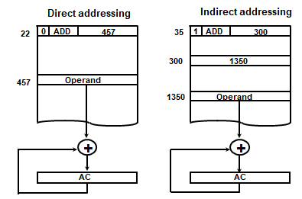
ADDRESSING MODES
The address field of an instruction can represent either
Direct address: the address in memory of the data to use (the address of the operand), or
Indirect address: the address in memory of the address in memory of the data to use
Effective Address (EA)
The address, that can be used directly (without modification) to access an operand for a computation-type instruction, Or, as the target address for a branch-type instruction
Figure 7. Addressing modes [1]

Slide 16
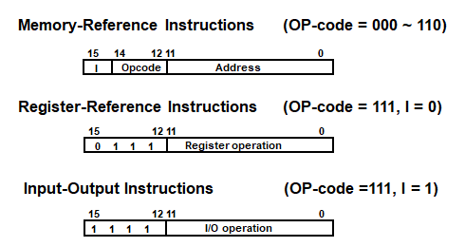
BASIC COMPUTER INSTRUCTIONS
Basic Computer Instruction Format
Figure 8. Basic computer instructions [1]

Slide 17
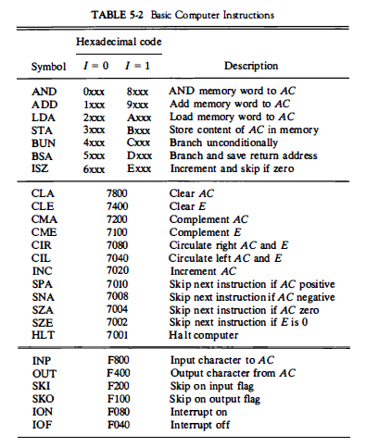
BASIC COMPUTER INSTRUCTIONS
Figure 9. Basic computer instructions [1]

Slide 18
COMMON BUS SYSTEM
The registers in the Basic Computer are connected using a bus
This gives a savings in circuitry over dedicated connections between registers.[3]
Data path also implies that how the data can flow through the Buses.
Bus is the interconnections through which voltage signal will be flowing.
Buses are used to send control signals and data between the processor and other components.
Address Bus: carries memory addresses from the processor to other components such as primary storage and input/output devices. The address bus is unidirectional.
Data Bus: carries the data between the processor and other components. The data bus is bidirectional.
Control Bus: carries control signals from the processor to other components. The control bus also carries the clock's pulses. The control bus is unidirectional.

Slide 19
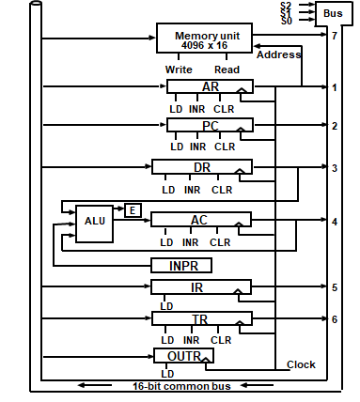
COMMON BUS SYSTEM
Figure 10. Common bus system [1]

Slide 20
COMMON BUS SYSTEM
Three control lines, S₂, S₁, and S₀ control which register the bus selects as its input
Either one of the registers will have its load signal activated, or the memory will have its read signal activated
Will determine where the data from the bus gets loaded
The 12-bit registers, AR and PC, have 0’s loaded onto the bus in the high order 4 bit positions
When the 8-bit register OUTR is loaded from the bus, the data comes from the low order 8 bits on the bus
S₂ S₁ S₀ Register
0 0 0 x
0 0 1 AR
0 1 0 PC
0 1 1 DR
1 0 0 AC
1 0 1 IR
1 1 0 TR
1 1 1 Memory

Slide 21
Memory
Divided into:
Bits 0 or 1
Bytes Groups of 8 bits A byte is the smallest unit of storage. (Can hold one text character)
Words Groups of bits/bytes (8, 16, 32, 64-bits)
Storage is usually too large to be expressed in bytes or words. Instead we use:
Kilobyte (KB) = 1024 bytes (2¹⁰ bytes)
Megabyte (MB) = 1024 x 1024 bytes or one million bytes (2²⁰ bytes)
Gigabyte (GB) = 1024 x 1024 x 1024 bytes orone trillion bytes (2³⁰ bytes)
Terabyte (TB) = 1024 x 1024 x 1024 x 1024 bytes one quadrillion bytes (2⁴⁰ bytes)

Slide 22
Main Memory
Each memory cell has a numeric address, which uniquely identifies its location
5248
5249
5250
5251
5252
5253
5254
5255
5256
Each memory cell stores a set number of bits (some computers use 8 bits/one byte, others use words)
10011010
A word is stored in
consecutive
memory bytes.
Figure 11. Main memory [2]

Slide 23
CPU and Memory
CPU can interact with main memory in two ways [2][3]:
It can write a byte/word to a given memory location.
The previous bits that were in that location are destroyed
The new bits are saved for future use.
It can read a byte/word from a given memory location.
The CPU copies the bits stored at that location and stores them in a CPU register
The contents of the memory location are NOT changed.

Slide 24
Main Memory Characteristics
Very closely connected to the CPU.
Contents are quickly and easily changed.
Holds the programs and data that the processor is actively working with.
Interacts with the processor millions of times per second.
Nothing permanent is kept in main memory.
Each computer has a specific word size
Word sizes vary from computer to computer.
Word size is an even multiple of a bytes.
Each word within memory can hold either
data or
program instructions

Slide 25
References
[1]. M. Morris Mano, Computer System Architecture, Prentice Hall of India Pvt Ltd, 3rd Edition (upda ted) , 30 June 2017.
[2]. Tanenbaum & Austin, Structured Computer Organization, 6th Edition, Pearson Education
[3]. William Stallings, Computer Organization and Architecture–Designing for Performance, Ninth Edition, Pearson Education, 2013.

